Slide 1






Home
About
Service
Contact
PLANTRICH
Empowering Farmers
Our Journey
Page 01

Slide 2


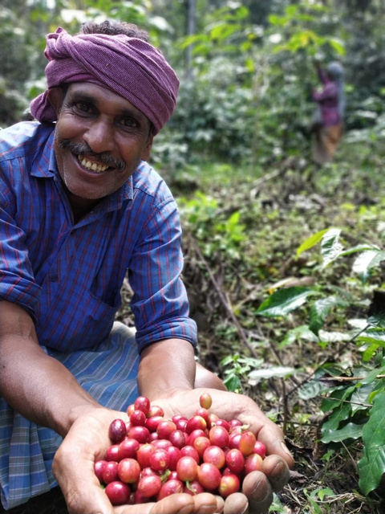
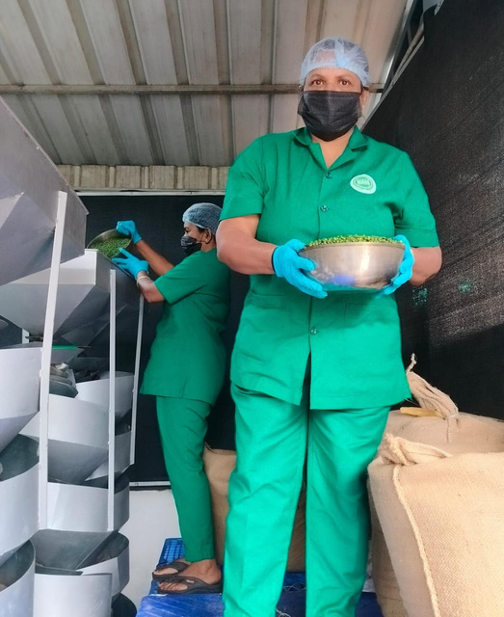
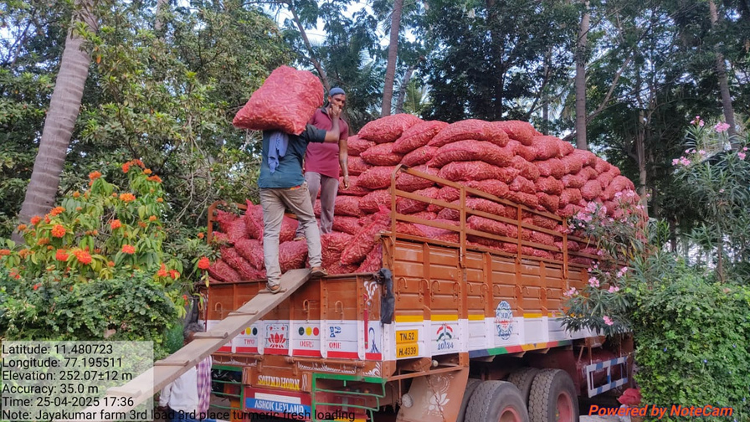
Home
About
Service
Contact
WHO WE ARE?
Established in 1997 and incorporated in 2008, Plantrich Agri Tech Pvt Ltd is a Kerala-based agribusiness dedicated to producing and exporting high-quality organic products. With a presence in over 25 countries, Plantrich specializes in organic spices, coffee, and herbs, all sourced sustainably from the Western Ghats region.
Our Vision
Our Mission
Quality Policy
Plantrich aims to be a global leader in sustainable organic agribusiness, delivering nature’s best while empowering farming communities.
Promoting ethical farming, fair trade, and premium organic products to foster environmental stewardship and community development.
Plantrich upholds top quality standards with certifications like USDA NOP, EU Organic, Fairtrade, Naturland, and Rainforest Alliance, ensuring traceability and compliance through ERP-integrated systems.
Page 02

Slide 3

Home
About
Service
Contact
MILESTONES
1997: Company founded in Kerala, India.
2008: Incorporated as Plantrich Agri Tech Private Limited.
2015: Achieved significant growth in organic spice exports.
2023: Celebrated 25 years of operations, marking a silver jubilee.
2025: Expanded global footprint, exporting to over 25 countries.
Page 03

Slide 4







Home
About
Service
Contact
ACCREDITATIONS & CERTIFICATIONS, AWARDS
Recognized for excellence in organic product exports and sustainable practices.
Page 04

Slide 5
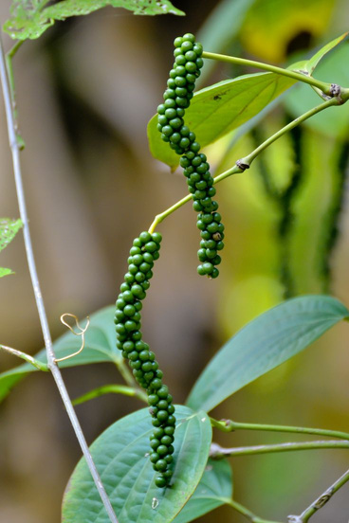
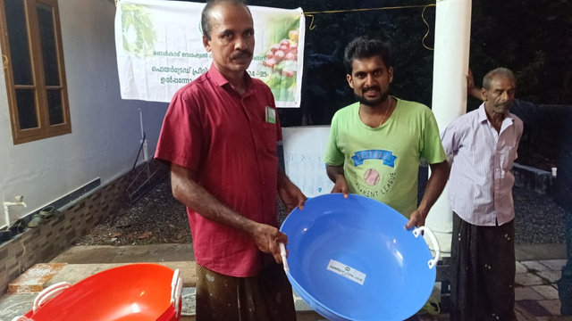
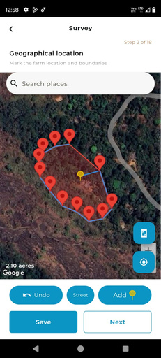




Home
About
Service
Contact
SUSTAINABILITY, ORGANIC & FAIR TRADE POLICIES
Traceability:
Utilizes ERP systems for full product traceability from farm to consumer.
Organic Farming:
Fair Trade:
Environmental Stewardship:
All products are cultivated without synthetic fertilizers or pesticides.
Ensures fair compensation and working conditions for over 5,000 partnered farmers.
Implements eco-friendly processing methods and waste reduction strategies
Page 05

Slide 6
Home
About
Service
Contact
Sustainability in Action (2024)
Metrics | Achievement
Organic Farms Partnered | 5,000+
Trees Planted | 50,000+
Fairtrade Premium Disbursed | 3 million USD
Renewable Energy Usage | 60%
Carbon Footprint Reduction | 25%
Page 06

Slide 7
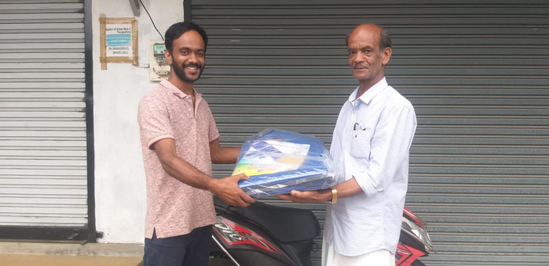

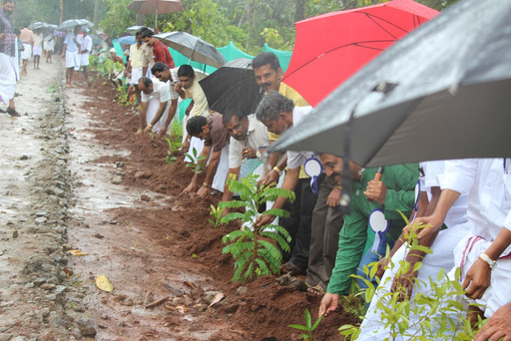
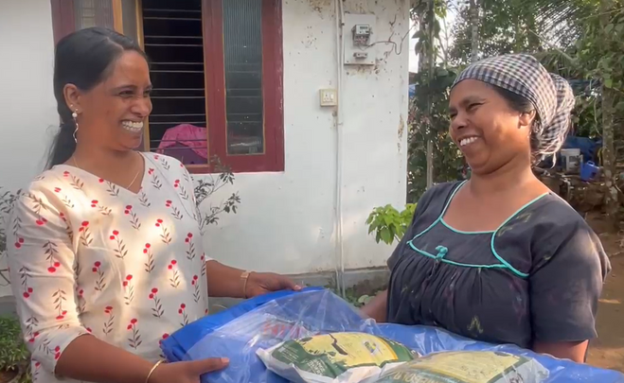
Home
About
Service
Contact
FUTURE SUSTAINABILITY GOALS
Expand Sustainable Farming: Grow farmer partnerships to 7,500 by 2026
Enhance Traceability: Strengthen HubTrace for real-time data monitoring.
Adopt Renewable Energy: Shift to 80% renewable energy by 2026.
Promote Gender Diversity: Achieve 50% women in leadership roles within 3 years.
Reduce Carbon Emissions: Cut emissions by 40% by 2027
Page 07

Slide 8
Home
About
Service
Contact
HUMAN RESOURCES AND DEPARTMENTS
Production Department:
Finance & Administration:
Operations & Marketing:
Oversees manufacturing processes and quality control
Manages financial operations and administrative tasks
Manages global client relationships and market expansion
Quality Assurance:
Workforce
Human Resources & IT:
Employs a diverse team of professionals, including food technologists, engineers, and marketing experts.
Ensures compliance with international standards
Handles recruitment, training, and employee welfare
Page 08

Slide 9
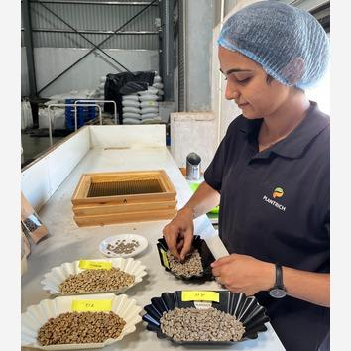
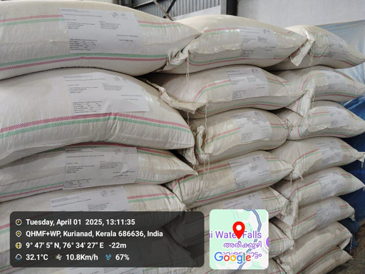


Home
About
Service
Contact
OUR STRENGTHS
Production Capabilities:
Global Reach:
Innovation:
Product Range:
Cutting-edge facilities for spice grinding, oil extraction, and coffee processing located in Andipatty (TN), Manarcadu and Kuriandad (Kerala), with an annual processing capacity of over 20,000 tons.
Exports to over 25 countries across Europe,US, North America, Australia & NZ
Continuous investment in R&D for product development and quality enhancement.
Green and roasted coffee beans and Organic spices, spice Extracts and oils
Page 09

Slide 10


Home
About
Service
Contact
Systems and ERP Integration
Inventory Management: Real-time tracking of raw materials and finished goods.
Quality Control: Automated monitoring to ensure product standards.
Supply Chain Management: Efficient coordination from sourcing to distribution.
Customer Relationship Management (CRM): Maintains client interactions and feedback.
Page 10

Slide 11











Home
About
Service
Contact
FIND US ON !
marketing@plantrich.com
biju@plantrich.com
Plantrich Agri Tech Pvt Ltd.
Mini Industrial Estate, Manarcadu P.O,
Kottayam - 686019, Kerala, India
Kurianad. Kerala
Coffee Profile
Spice Profile
+91 481 2371877
+91 9495592260
+91 9846524151
Andipatti, Tamilnadu
www.plantrich.com
Page 11

